Slide 1

Accurate Snow Simulation
Colter Snyder and Elijah Mt. Castle

Slide 2
Background

Slide 3
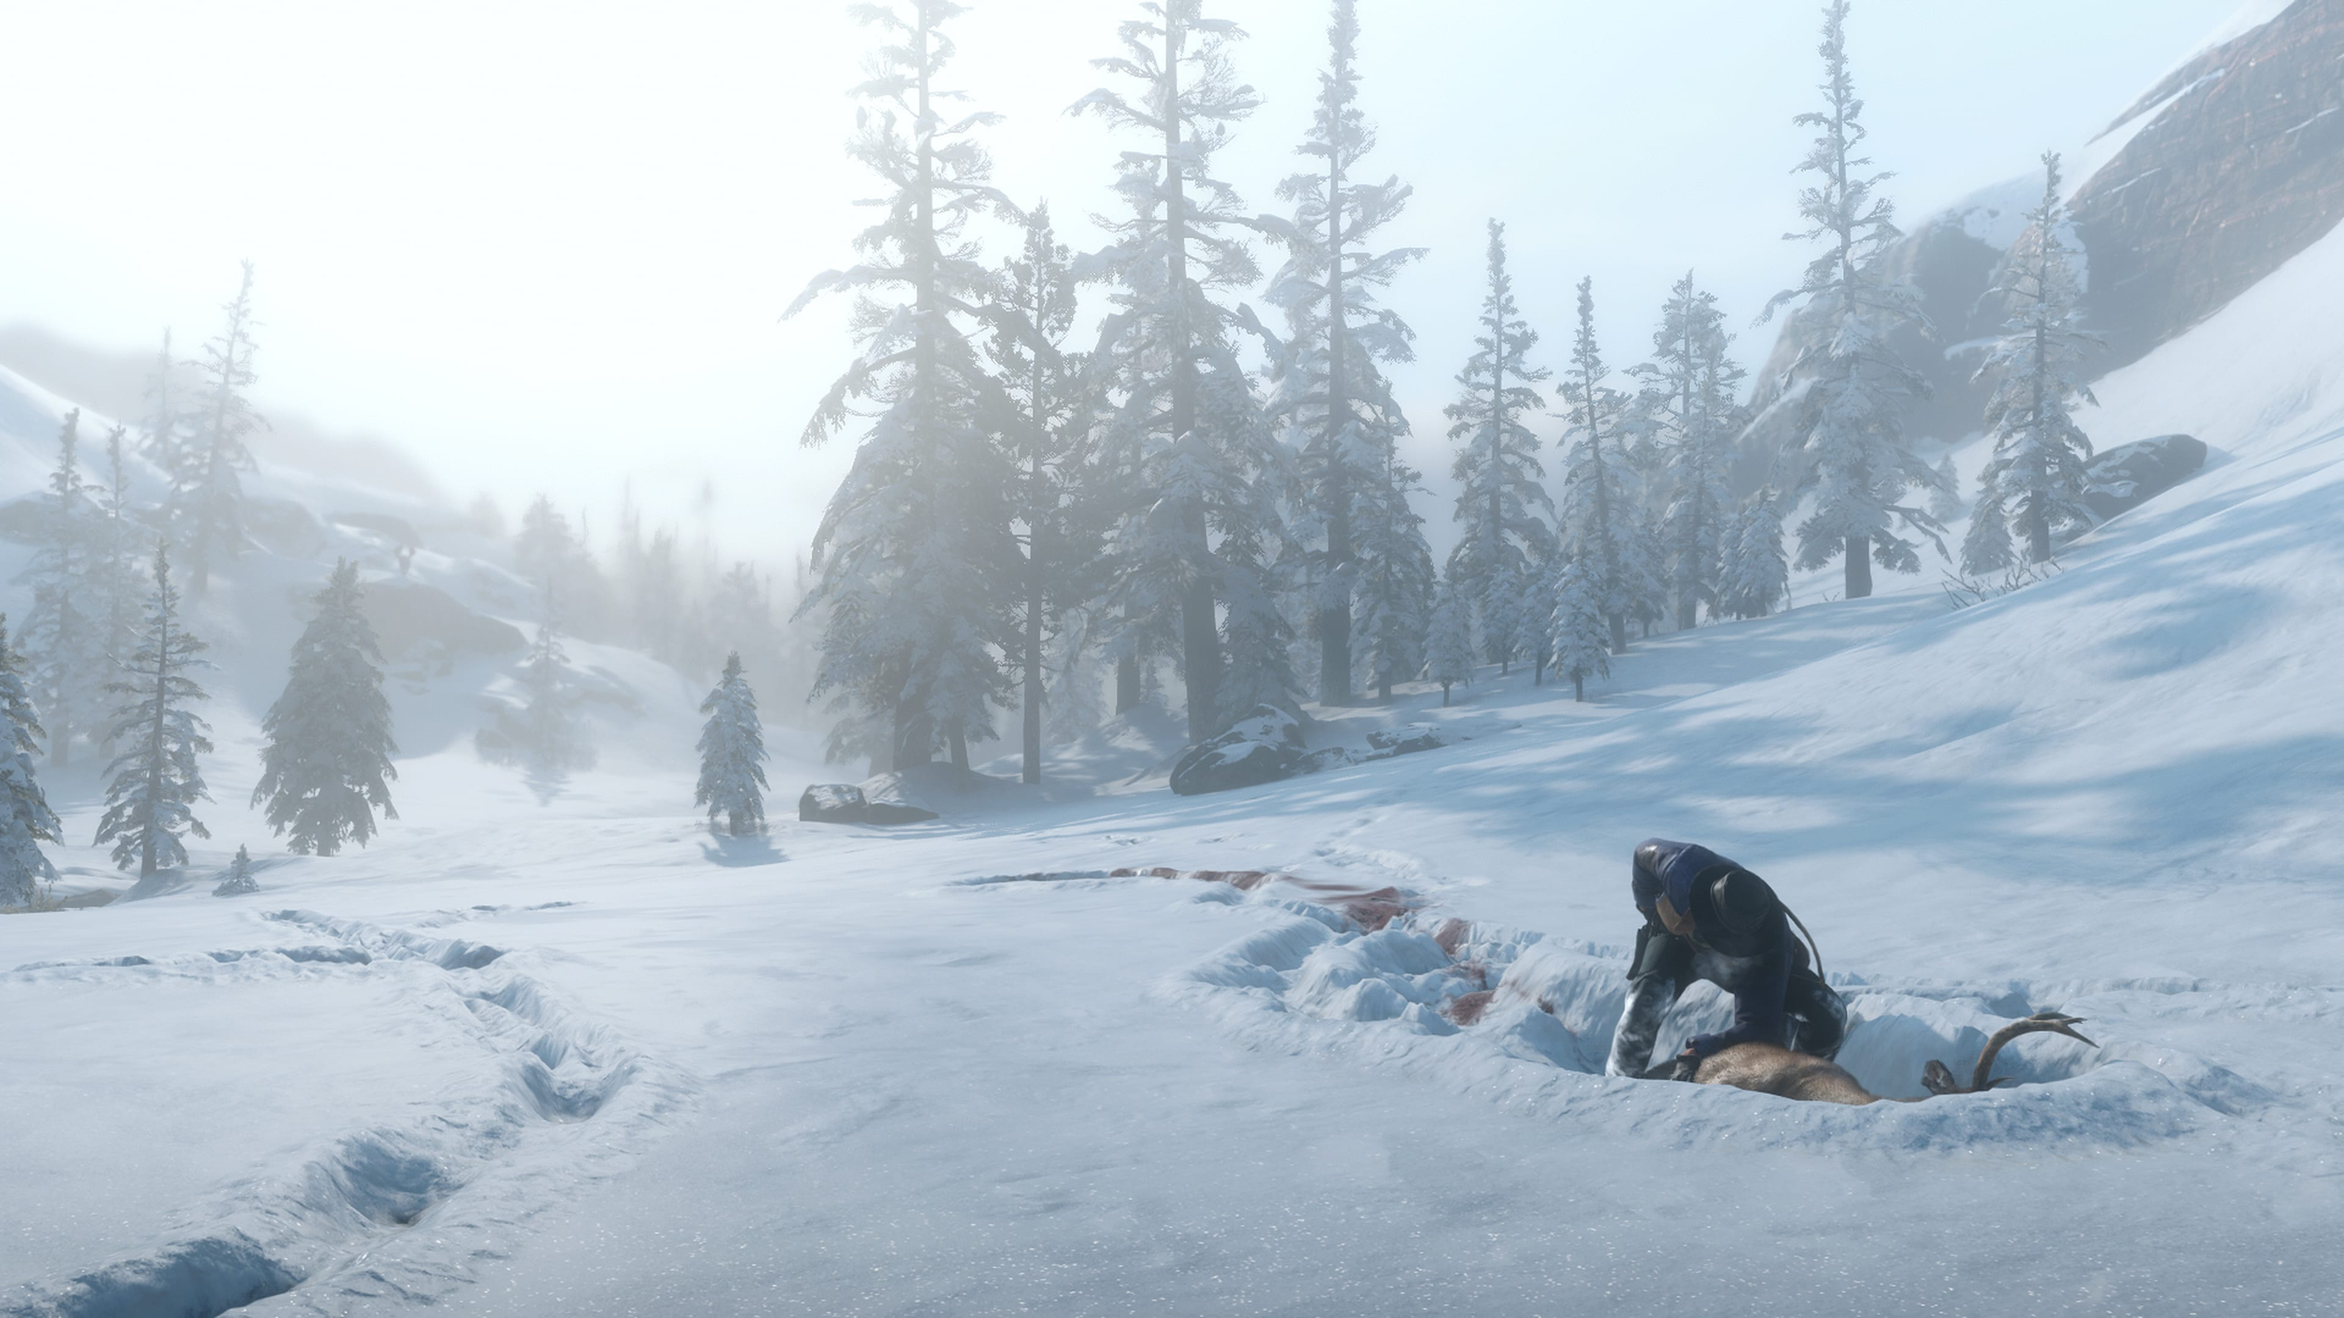
Inspiration
Red Dead Redemption 2
Fantastic Snow Physics
Image Source: https://i.redd.it/2g9njmrqq7o11.jpg

Slide 4
Implementations

Slide 5
Our Implementation

Slide 6
Sources
https://www.gamedeveloper.com/programming/rendering-and-simulation-in-offroad-driving-game
https://www.gamedeveloper.com/programming/mud-and-water-of-spintires-mudrunner
https://www.gamedev.net/forums/topic/700247-snow-physics-in-red-dead-redemption-2/5396779/

